Slide 1
US Core Track HL7 FHIR CMS Connectathon Orientation
Tuesday, Jan 7th & Wednesday, Jan 8th, 2020
Centers for Medicare & Medicaid Services Headquarters,Baltimore, MD
Track Lead: Eric Haas

Slide 2
Connectathon Overview
LINK: 2020-01 CMS FHIR Connectathon 1
WHEN: Tuesday, Jan 7th & Wednesday, Jan 8th, 2020
WHERE: Centers for Medicare & Medicaid Services Headquarters, Baltimore, MD

Slide 3
Connectathon Overview
FHIR Connectathon Objectives
Timeline of Activities
Track Selection
FHIR Connectathon Objectives and Participant Opportunities
US Core Track
How to get your questions answered
Location of Support Materials

Slide 4
Timeline of Activities: Registration
One Month Prior (aka NOW!!)
Register to attend the Connectathon, and make sure to select the Connectathon option when you do
All participants should attend the Connectathon Info Session on December 19th at 10:00 AM ET.
Read the Track descriptions found in the drop down list on the left under Tracks for 2020-01 CMS FHIR Connectathon 1
SELECT A TRACK Complete the HL7 FHIR Pre-Connectathon Survey for each member of your team to indicate their primary track.

Slide 5
Track Selection
Review track details here to find your focus
Select your track in the Pre-Connectathon Survey
Connect with your track lead in advance
We recommend participating fully in only one track

Slide 6
Timeline of Activities: Track Orientation
NOW: Track Orientation Meeting
Slides
Webinar
Select Track ( if you haven’t already)

Slide 7
Timeline of Activities: On Site
WHEN: Tuesday, Jan 7th & Wednesday, Jan 8th, 2020
WHERE:Centers for Medicare & Medicaid Services Headquarters, Baltimore, MD
Tuesday
Q1-Q4: Working Sessions
Breakouts: Orientations on FHIR and Test Tools
Wednesday
Q1-Q2 Working, Q3 Testing, Q4 Wrap Up

Slide 8
What’s to be gained by attending a FHIR Connectathon?
Join a community of FHIR users
Develop and test your system using related standards
Demonstrate what’s possible
Refine the FHIR Specification

Slide 9
Participant Opportunities
Join in the community
Ask questions and help identify hot topics
Collaborate to find solutions to implementation issues
Bring your development system ready to go
Have your application installed
Have your environment configured
Record your results
What happens at Connectathon stays at Connectathon.
It’s OK to fail.

Slide 10
Intro to US Core Track
Track Resources
Track Definition
List of participating systems in the track
References to the servers & clients for the track
Goals for this track

Slide 11
Track Resources
Track Leads – Eric Haas (ehaas@healthedatainc.com), Brett Marquard (brett@waveoneassociates.com)
US Core Implementation Guide:
Expectation is that participants have read and reviewed the guide prior to the Connectathon
http://hl7.org/fhir/us/core/
US Core Connectathon Page
https://confluence.hl7.org/display/FHIR/2020-01+US+Core
Connectathon Manager
http://conman.clinfhir.com/connectathon.html?event=baltimore2020
FHIR Chat: https://chat.fhir.org/#narrow/stream/179175-argonaut

Slide 12
Track Definition
Goal: Conformance to the profiles and be capable of responding to all of the “supported transactions” specified in the US Core Implementation Guide Server CapabilityStatement.
US Core System Roles
Scenarios
Core
Bonus

Slide 13
Scenarios: Search
Test the servers for conformance to the ArgoR4/US Core profiles response to all of the “supported searches” documented in the "Quick Start" sections and specified in the Argonaut Data Query Implementation Guide Server CapabilityStatement for these profiles
Bonus: Successfully retrieve US Core V3.1.0 artifacts using search parameters defined as “SHOULD support”

Slide 14
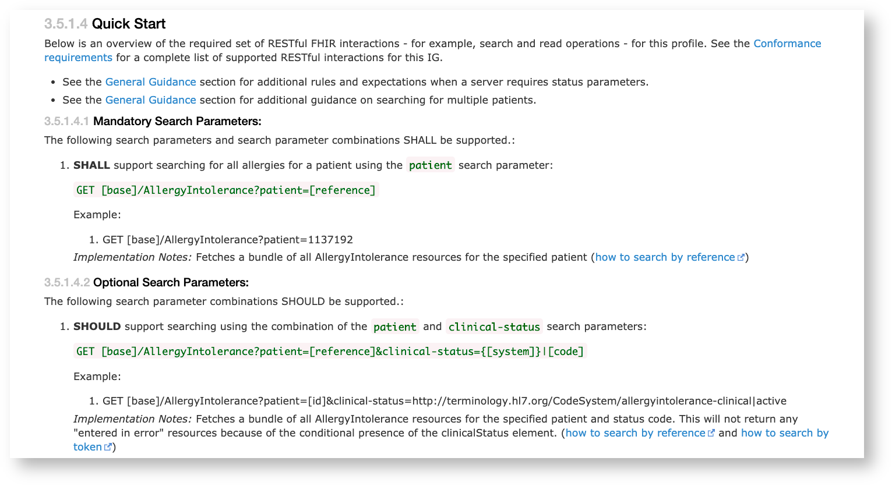
Scenarios: Search
For Example in US Core AllergyIntolerance Quick Start:
For Example in US Core AllergyIntolerance Quick Start:

Slide 15
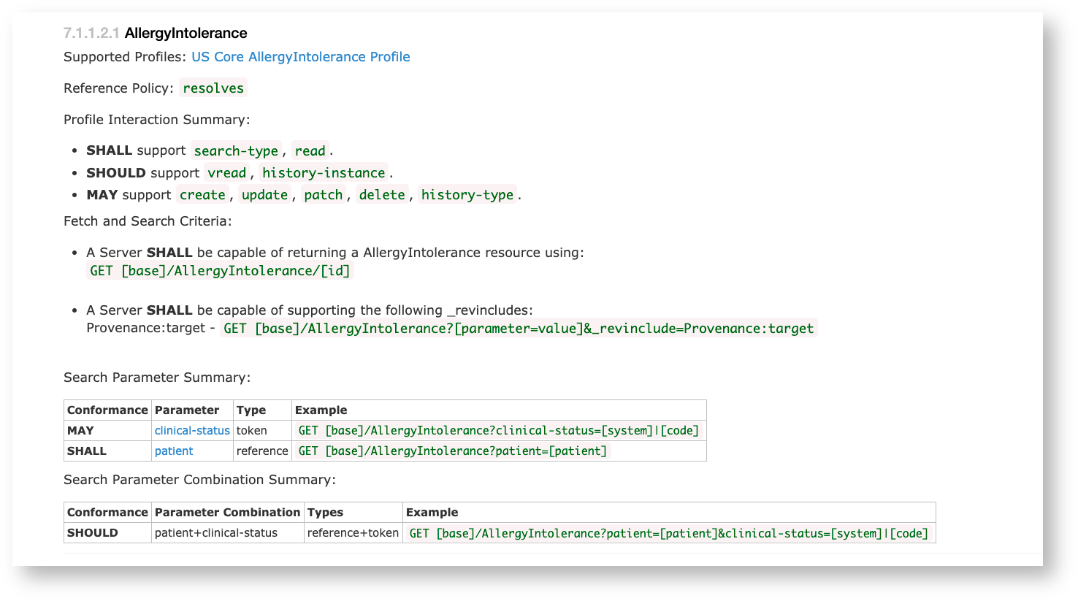
Scenarios: Search
... and the corresponding CapabilityStatement:

Slide 16
Scenarios: Provenance
Successfully retrieve data provenance in addition to the clinical data for a single patient using the included US Core V3.1.0 Provenance artifacts with the “SHALL support” searches specified in the Argo R4 IG Provenance Quick Start section.

Slide 17
Scenarios: “on-demand” CCD
Successfully retrieve a "on demand" CCD document for a single patient using the $docref operation specified in the US Core V3.1.0 IG.

Slide 18
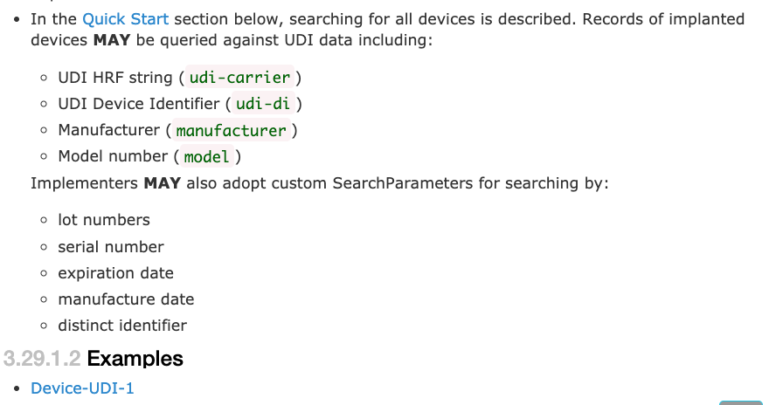
Bonus Scenarios: UDI
Additional pilot Testing of UDI elements - US Core includes all the component parts of UDI in US Core Implantable Device profile.

Slide 19
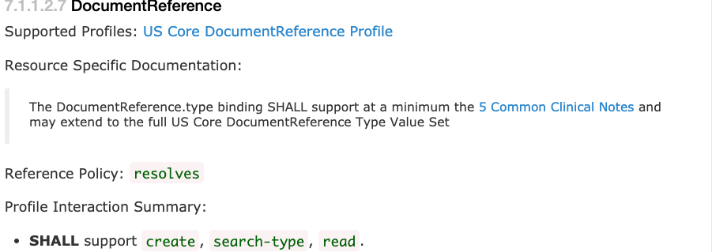
Bonus Scenario: Write
Very little guidance is provided on writing and updating data in the context of US Core profiles. There are multiple issues that will need to be considered when defining expected behavior by the various actors to support updates and writes to the data including: Currently the IG defines write for Clinical notes as described in the Clinical Notes Guidance Page.

Slide 20
How to Sign up….
For this Connectathon we are using the official Conman tool for signup
http://conman.clinfhir.com/connectathon.html?event=baltimore2020
Enter your name/organization
Identify US Core as your primary track
url for your system and any instructions how to access ( e.g., credentials )
(See the Sprint Tracker! spreadsheet for participants in the 2019 September Connectathon.)

Slide 21

Test Systems
Client: https://inferno.healthit.gov/inferno/
Servers: Many FHIR Reference Implementations listed here support US Core Profiles to various degrees

Slide 22
How to Get your Questions Answered
FHIR Chat:
https://chat.fhir.org/#narrow/stream/179207-connectathon-mgmt/topic/Clinical.20Reasoning.20Track
Track Lead: Eric Haas (ehaas@healthedatainc.com)
Track Lead: Brett Marquard (brett@waveoneassociates.com)
On Site Issues: Sandy Vance (sandra.vance@aegis.net)

Slide 23
Location of Support Materials
FHIR Specification:
R4 final: http://hl7.org/fhir/index.html
US Core Implementation Guide
http://hl7.org/fhir/us/core/
CMS 2020 Connectathon Page
https://confluence.hl7.org/display/FHIR/2020-01+CMS+FHIR+Connectathon+1
US Core Connectathon Page
https://confluence.hl7.org/display/FHIR/2020-01+US+Core
Connectathon Manager
http://conman.clinfhir.com/connectathon.html?event=baltimore2020
JIRA: https://jira.hl7.org/projects/FHIR/issues
FHIR Chat: https://chat.fhir.org/

Slide 24
Discussion & Questions

Slide 25
Action Items
Who is planning to attend?
Schedule any Breakouts?
Do we need a preconnectathon session?
Load resources to a reference Server?

